Slide 1
MULTIMODAL HASHTAG GENERATION FOR INSTAGRAM POSTS
IRE TEAM 13

Slide 2
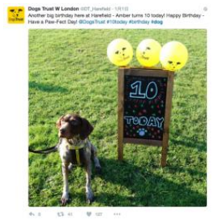
INTRODUCTION
Multi-modal post on OSM
Images + Text
Generate hashtags

Slide 3
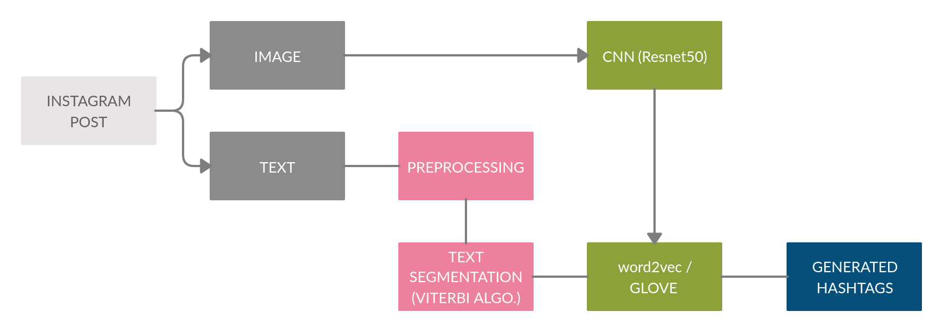
PIPELINE

Slide 4

DATA COLLECTION
Pre-existing datasets: YFCC100M and HARRISON
Only Images
Create our own dataset by scraping Instagram

Slide 5
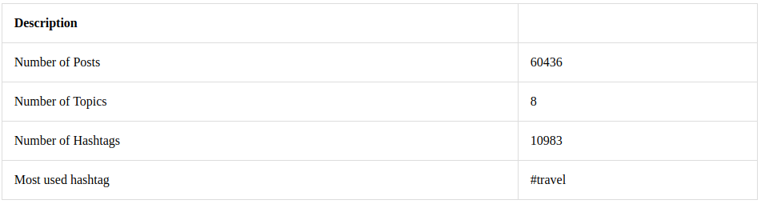
DATASET DESCRIPTION

Slide 6
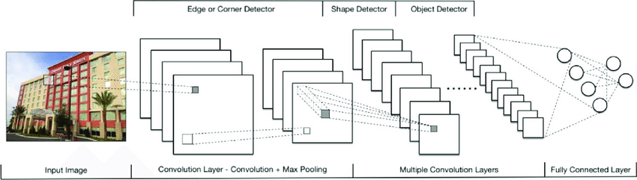
IMAGE CLASSIFIER
CNNs for image classification
Finetuned on our dataset using transfer learning (Resnet 50)

Slide 7
PREPROCESSING (TEXT)
Hashtag Segmentation - Viterbi algorithm
Stemming
Word embeddings

Slide 8
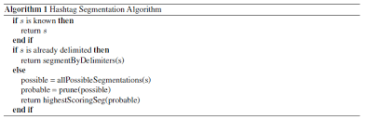
HASHTAG SEGMENTATION
Hashtags are complex
Segment hashtags into longest meaningful segments
Viterbi algorithm -> Unigram
With segmentation:
31% accuracy increase

Slide 9
TRAINING (TEXT APPROACH)
Topic based:
Glove
Word2Vec
Global Model (All topics):
Glove
Word2Vec
Word2Vec model trained on top of Pre-trained Wikipedia embeddings.

Slide 10
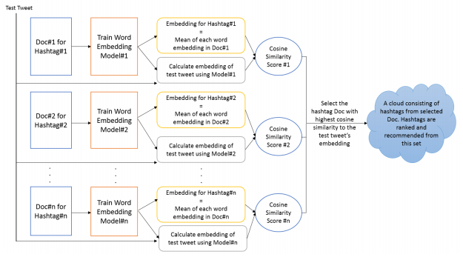
Topic Based Word Embeddings

Slide 11
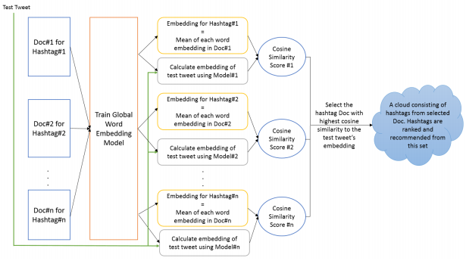
Global Word Embeddings

Slide 12
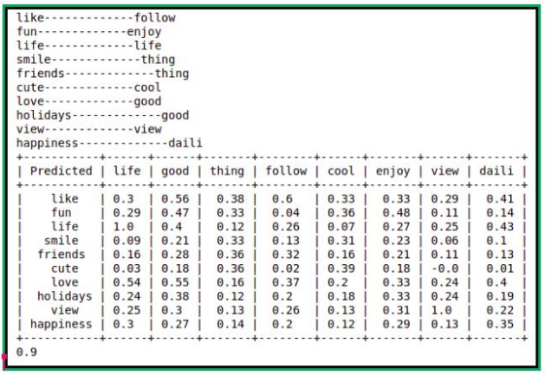
EVALUATION METRICS

Slide 13
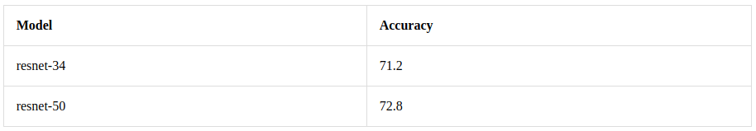
IMAGE CLASSIFIER RESULTS
Multi-class task (8 labels)
Semi-annotated data

Slide 14
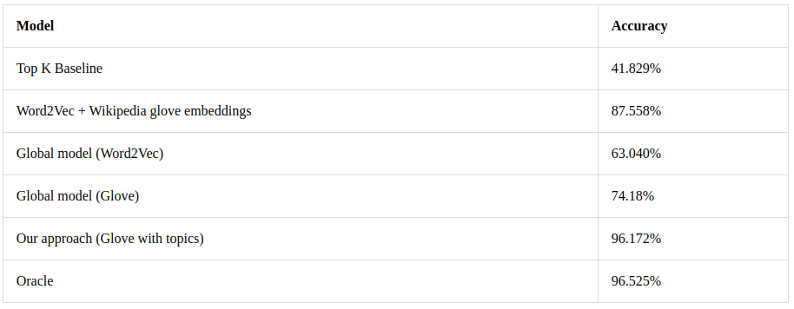
RESULTS

Slide 15
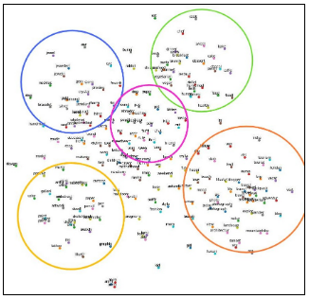
ANALYSIS
Dimensionality reduction
LDA + TSNE
Clusters of 5 topics
Embeddings have semantic meanings

Slide 16
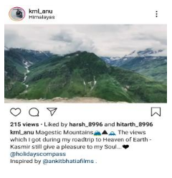
QUALITATIVE RESULTS
#view
#mountain
#world
#amazing
#ig

Slide 17
THANK YOU

